Slide 1
Group theory in Particle Physics and Supersymmetry
Evin O’Shea

Slide 2
What is supersymmetry?
Supersymmetry is a theory about the relationship between bosons and fermions
Extension of similar symmetry models
Predicts “superpartners”

Slide 3
Group theory
In quantum mechanics, operators act on states
Eigenvalues correspond to observables
There is an “algebra” of these operators

Slide 4

Spin matrices
$$\left[σ_{x}, σ_{y}\right]=2iσ_{z}$$
$$\left[σ_{y}, σ_{z}\right]=2iσ_{x}$$
$$\left[σ_{z}, σ_{x}\right]=2iσ_{y}$$
$$\left[σ_{x}, σ_{x}\right]=0$$
$$\{σ_{x}, σ_{x}\} =2I$$

Slide 5
Irreducible representations
These abstract groups can be mapped to matrices and other operators
For spin, different irreducible representations correspond to different values of total angular momentum
An irreducible representation can tell eigenvalues of operators

Slide 6

Isotopic spin
The degeneracy of angular momentum is $2l + 1$
Give proton and neutron an “isotopic spin”, $I =\frac{1}{2}$
Proton: $I_{3}=\frac{1}{2}$
Neutron: $I_{3}=−\frac{1}{2}$

Slide 7
Hypercharge
We give particles the property of Strangeness “S”
Conservation of Strangeness
Hypercharge: Y = B + S

Slide 8

The algebra of Isotopic spin and hypercharge
$\left[Y, I_{p}\right]=0$
$\left[Y, I^{2}\right]=0$
$\left[Y, Y\right]=0$
Y, $I_{3}$ members of $A_{2}$
Weights of irreducible representations give eigenvalues

Slide 9
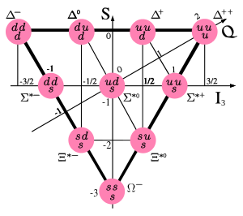

Irreducible representations of The complexification of SU(3) ($A_{2}$)
These correspond to different particles
Weights give quantum numbers
{3} <=> {3*}
There is not conjugate for {8}

Slide 10
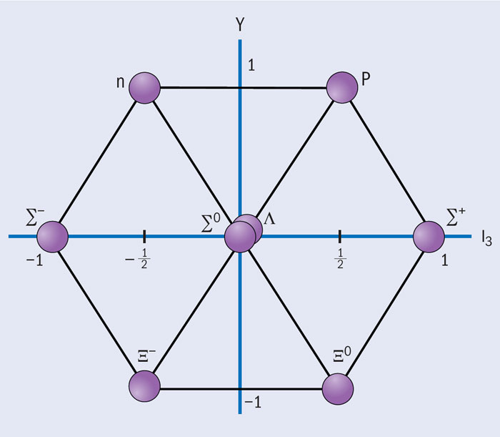
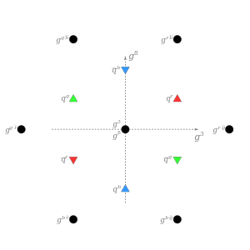

More Representations of $A_{2}$

Slide 11

Supersymmetry Algebra
A super (or graded) Lie Algebra
$\left\{Q_{r},{\overline{Q}}_{s}\right\}=2γ_{rs}^{μ} P_μ$
$\left[Q_{r}, P^{μ}\right]=0$
$\left[Q_{r}, M^{μν}\right]=iσ_{rs}^{μν}Q_{s}$

Slide 12

Irreducible representations of the supersymmetry algebra
Irreducible representations of the Supersymmetry Algebra correspond to supermultiplets
A “ground state” with helicity $λ_{0}$
Creation operator: $Q_{r}^{†}$

Slide 13

Supermultiplets
N = 1 ; $λ_{0}$ = - $\frac{1}{2}$, 0
Helicity: - $\frac{1}{2}$ 0 $\frac{1}{2}$
States: 1 2 1

Slide 14
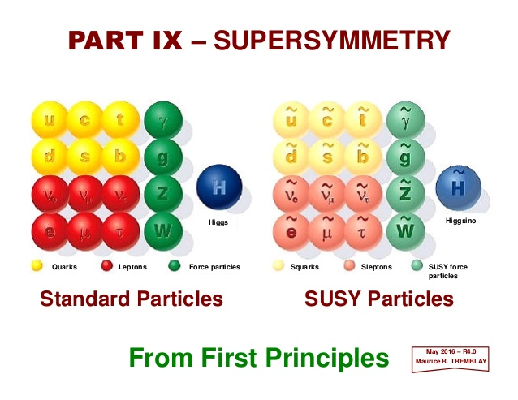
Conclusion
A relationship between bosons and
fermions
Similar to SU(3) x SU(2) x U(1)
Irreducible representations
manifest in superpartners

Slide 15
References
Binetruy, Pierre. Oxford Graduate Texts : Supersymmetry : Theory, Experiment, and Cosmology. Oxford, GB: OUP Oxford, 2006. ProQuest ebrary. Web. 5 December 2016.
Cornwell, John F.. Techniques of Physics : Group Theory in Physics : An Introduction. Oxford, GB: Academic Press, 1997. ProQuest ebrary. Web. 5 December 2016.

Slide 16
Pictures
http://images.iop.org/objects/ccr/cern/52/8/19/CCqcd1_08_12.jpg
http://image.slidesharecdn.com/linked-inslides-ss-150212162339-conversion-gate01/95/part-ix-supersymmetry-1-638.jpg?cb=1473384986
https://upload.wikimedia.org/wikipedia/commons/thumb/5/53/Baryon-decuplet.svg/600px-Baryon-decuplet.svg.png
https://upload.wikimedia.org/wikipedia/commons/thumb/b/b6/Strong_force_charges.svg/300px-Strong_force_charges.svg.png

